Slide 1



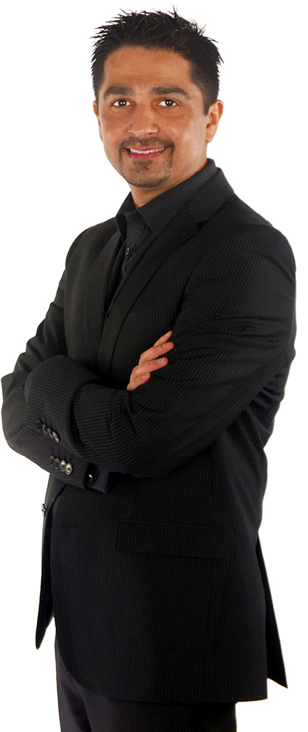

13 & 14 january 2017
Advances in Psycho-oncology :
CERTIFICAT INTERUNIVERSITAIRE EN PSYCHO-ONCOLOGIE
Meeting Prof. A. Mitchell

Slide 2
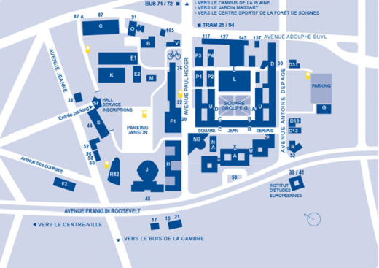


FRIDAY 13 JANUARY
PROGRAM
8H30 | REGISTRATION AND BREAKFAST
9H00-9H20 | Introduction and presentation of Prof. Mitchell Isabelle Merckaert
9H20-10H10 10H10-10H30 | Evidence based screening for distress / depression / anxiety [research focus] A. Mitchell Discussion I. Merckaert
10H30-10H50 | COFFEE BREAK
10H50-11H40 11H40-12H00 | Acceptability of psychosocial interventions : desire/ response/uptake [clinical focus] A. Mitchell Discussion I. Merckaert
12H00-13H30 | LUNCH
13H30-14H20 14H20-14H50 | Peer support in Cancer : focus on Cancer Stories [patient & volunteer focus] A. Mitchell Discussion I. Merckaert
15H00 | Closing Remarks I. Merckaert

Slide 3
SATURDAY 14 JANUARY
PROGRAM
8H30 | REGISTRATION AND BREAKFAST
9H00-9H20 | Introduction of the day Isabelle Merckaert
9H20-10H10 10H10-10H30 | Project presentation of the team of Prof. Razavi Discussion A. Mitchell
10H30-10H50 | COFFEE BREAK
10H50-11H40 11H40-12H00 | Physical health inequalities due to severe and non-severe mental illness A. Mitchell Discussion I. Merckaert
12H00-13H30 | LUNCH
13H30-14H20 14H20-14H50 | Getting published in liaison psychiatry and psycho-oncology; career perspective A. Mitchell Discussion I. Merckaert
15H00 | Closing Remarks I. Merckaert
Address: ULB, avenue A. Depage, 30, 1050 Brussels, building D, DC2-206
Coordinator : I. Merckaert : 0032 478 843 502
Information and registration: C.P.O.: 0032 2 538 03 27

