Slide 1



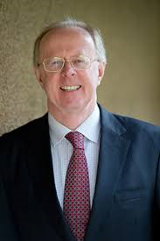


21 & 22 April 2017
Advances in Psycho-oncology
CERTIFICAT INTERUNIVERSITAIRE EN PSYCHO-ONCOLOGIE
Meeting Prof. d. Kissane

Slide 2
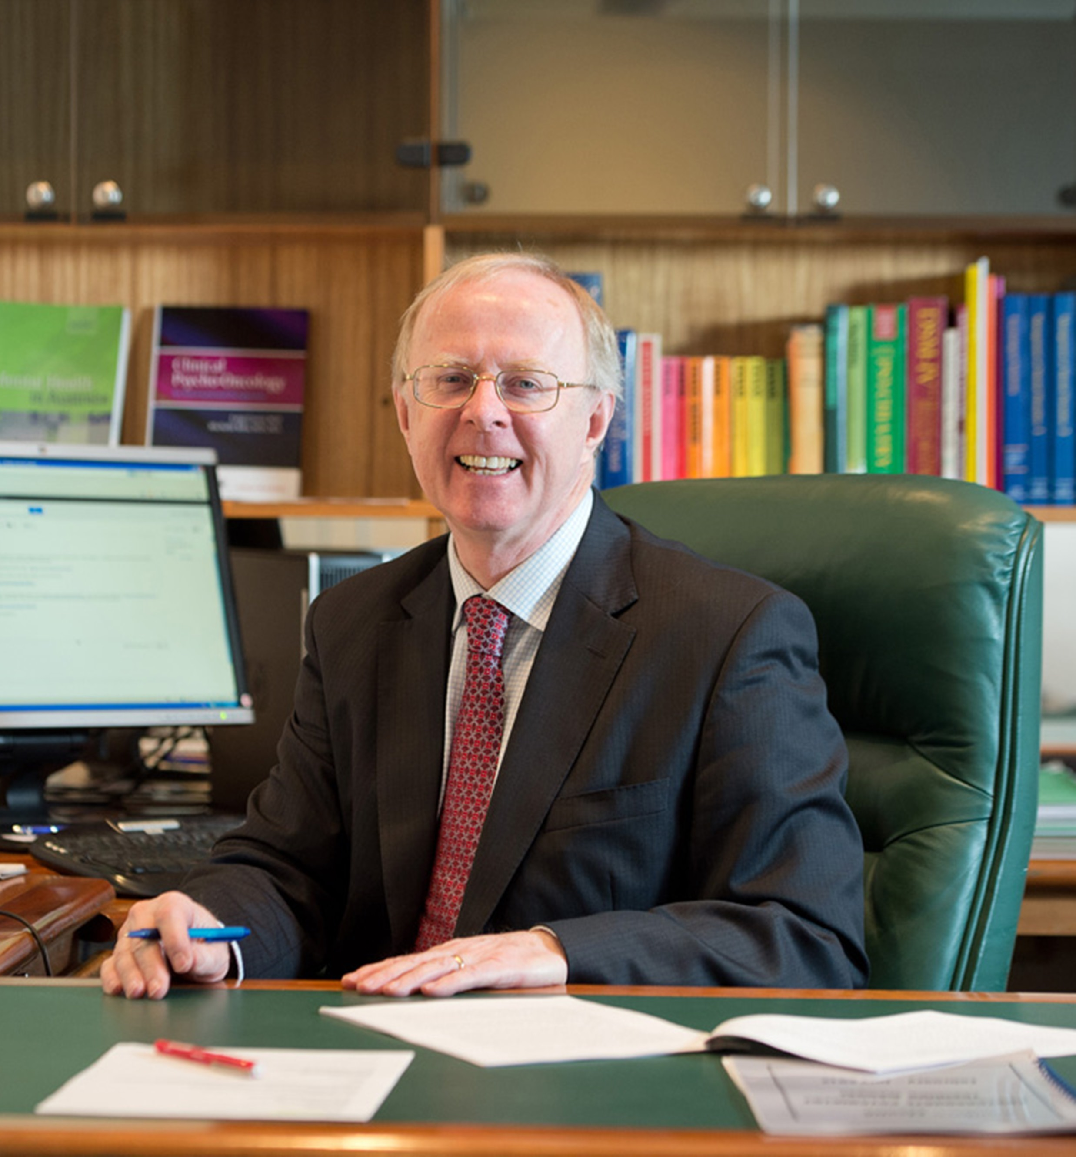
FRIDAY 21 APRIL
PROGRAM
8H30 | REGISTRATION AND BREAKFAST
9H00-9H20 | Introduction and presentation of Prof. Kissane Isabelle Merckaert
9H20-10H10 10H10-10H30 | ‘The art and science of psycho-oncology’: Overview and challenges D. Kissane Discussion I. Merckaert
10H30-10H50 | COFFEE BREAK
10H50-11H40 11H40-12H00 | The diagnosis and treatment of Demoralization in cancer care D. Kissane Discussion I. Merckaert
12H00-13H30 | LUNCH
13H30-14H20 14H20-14H50 | Existential challenges towards the end-of-life: Meaning and Purpose (MaP) Therapy D. Kissane Discussion I. Merckaert
15H00 -15H30 | Closing Remarks I. Merckaert

Slide 3
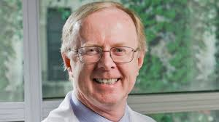
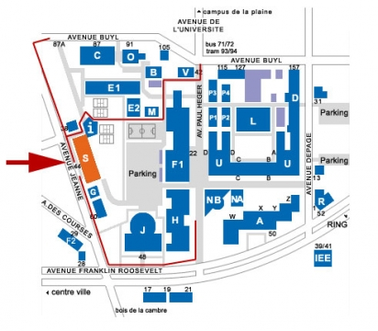
SATURDAY 22 APRIL
PROGRAM
8H30 | REGISTRATION AND BREAKFAST
9H00-9H20 | Introduction of the day I. Merckaert
9H20-10H10 10H10-10H30 | Presentation of a Randomized Controlled Trial of Family Therapy in Advanced Cancer Continued Into Bereavement D. Kissane Discussion I. Merckaert
10H30-10H50 | COFFEE BREAK
10H50-11H40 11H40-12H00 | Running a family meeting : communication skills training workshop D. Kissane Discussion I. Merckaert
12H00-13H30 | LUNCH
13H30-14H20 14H20-14H50 | Career in psycho-oncology D. Kissane Discussion I. Merckaert
15H00-15H30 | Closing Remarks I. Merckaert
Address: ULB, avenue Jeanne, 44, 1050 Brussels, Building S, First floor, room Dupréel
Coordinator : I. Merckaert : 0032 478 843 502
Information and registration: 0032 2 538 03 27

Slide 4

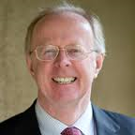
Professor David KISSANE
David.Kissane@monash.edu
David Kissane is an academic psychiatrist, psycho-oncology researcher and author.
He is currently the Head of Psychiatry for Monash University in Australia, recently the Chairman of the Department of Psychiatry and Behavioral Sciences at Memorial Sloan-Kettering Cancer Center in New York and previously the Foundation Chair of Palliative Medicine at the University of Melbourne.
RESEARCH INTERESTS:
  Psycho-oncology, palliative care, psychotherapy trials, family/couples/group therapy
  Communication skills training
  Existential distress
  Ethics of end-of-life care
RESEARCH METHODS:
  Cognitive-existential model of group therapy for women with early stage breast cancer, which ameliorated fear of recurrence, and his trial of supportive-expressive group therapy for advanced breast cancer showed the prevention of depression alongside improved quality of life.
  Model of family therapy delivered to at risk' families during palliative care, which prevents complicated grief and depression in bereavement.
  His work on demoralization as a variation of depression in the medically ill has preceded interventions to promote meaning-based coping.
CLINICAL ACTIVITIES:
  2003-2012
  Attending Psychiatrist, Memorial Sloan-Kettering Cancer Center and Memorial Hospital, New York, NY
  Liaison attachments with Breast, Head and Neck and Gynecologic Disease Management Teams. Outpatient clinics twice weekly. Inpatient consultation and Psychiatry Fellow Supervision once weekly.
  1998 - 2003
  Development of a Psycho-oncology Service at St. Vincent's Hospital, Melbourne. Conduct of weekly outpatient and inpatient consultation-liaison service to the oncology unit and hospice inpatients.
  1996 - 2003
  Monthly supervision of psycho-social services at Melbourne City mission and Eastern Palliative Care, community-based programs.
  1996 - 2003
  Provision of a consultation-liaison service to Caritas Christi Hospice at its Kew and Fitzroy Campuses.
Communication Skills Training and Research Laboratory, which developed an applied curriculum for oncology, training over 700 clinicians.
His books include the Handbook of Communication in Oncology and Palliative Care with Oxford University Press, Handbook of Psychotherapy in Cancer Care with Wiley-Blackwell, Cancer and Depression for the World Psychiatric Association and Family Focused Grief Therapy with Open University Press.
He was awarded the Jimmie C. Holland Chair in Psycho-oncology at MSKCC and was recognized by the International Psycho-Oncology Society in 2008 with their Arthur Sutherland Award for lifetime achievement.

