Slide 1






Groupe de Contact FNRS «Psycho-oncologie»
Advances in Psycho-oncology
Saturday, 28 March 2015
8:30 Registration and Breakfast
9:00 Introduction
A.-M. Etienne and D. Razavi
9:05 Communication at the end-of-life: What we know today P. Butow
10:00 Discussion
Y. Libert
10:30 Coffee Break
10:50 Communication at the end-of-life: What are the Challenges for the Future P. Butow
11:40 Discussion
Ch. Reynaert
12:10 Lunch
13:30 Topic to be defined
J. Turner
14:45 Discussion
Aurore Liénard
15:10 Closing remarks
D. Razavi
Meeting Prof. P. Butow and Prof. J. Turner
Friday, 27 March 2015
8:30 Registration and Breakfast
9:00 Introduction
D. Razavi
9:05 Presentation of Prof. Ph. Butow and Prof. J. Turner
I. Merckaert
9:10 Fear of reccurence: Theoretical underpinnings of the Conquer Fear
intervention
P. Butow/J. Turner
10:00 Discussion
I. Merckaert
10:30 Coffee Break
10:50 Conquer Fear : Description, content and preliminary results of the
intervention
P. Butow/J. Turner
11:40 Discussion
I. Merckaert
12:10 Lunch
13:30 Attention training and detached mindfulness : examples of exercises
P. Butow/J. Turner
14:20 Discussion
Y. Libert
14:40 Dealing with threat monitoring and challenging metacognitions
P. Butow/J. Turner
15:30 Discussion
Y. Libert
16:00 Closing remarks
D. Razavi

Slide 2
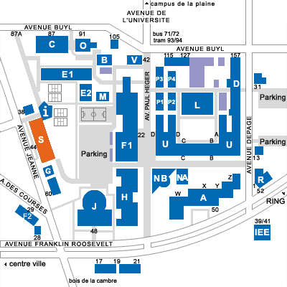
MEETING ADDRESS
Université Libre de Bruxelles
Campus du Solbosch
Bâtiment UB2-147
B-1050 BRUSSELS
INFORMATION-INSCRIPTION
http://www.psycho-oncologie.be
Contact: events@cbpo.be - Tel: 0032 2 538 03 27
Valérie Mérien (C.P.O.)

