Slide 1
Advances in Psycho-oncology
Meeting Prof. F. Penedo
Friday, 07 october 2016
8h30 | Registration and breakfast
9h00-9h20 | Introduction and presentation of Prof. Penedo Isabelle Merckaert
9h20-10h10 10h10-10h30 | Cognitive behavioral stress management (CBSM) : Psychosocial intervention in prostate cancer survivors. Face to face interventions, Technology based intervention F. Penedo Discussion
10h30-10h50 | Coffee Break
10h50-11h40 11h40-12h00 | Biobehavioral mechanisms in prostate cancer symptom burden F. Penedo Discussion
12h00-13h30 | Lunch
13h30-14h20 14h20-14h50 | Enhancing standards of cancer care by capturing patient experiences (distress screening) and implementing survivorship care planning F. Penedo Discussion
15h00 | Closing Remarks

Slide 2
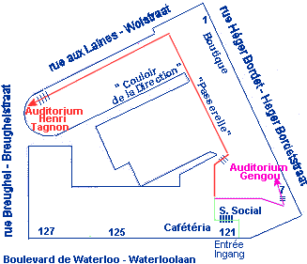

MEETING ADDRESS
Coordinator : Isabelle Merckaert
Institut Jules Bordet
Meeting, registration, breakfast and coffee break:
Auditoire Tagnon
Boulevard de Waterloo, 121
1000, Bruxelles

